Slide 1
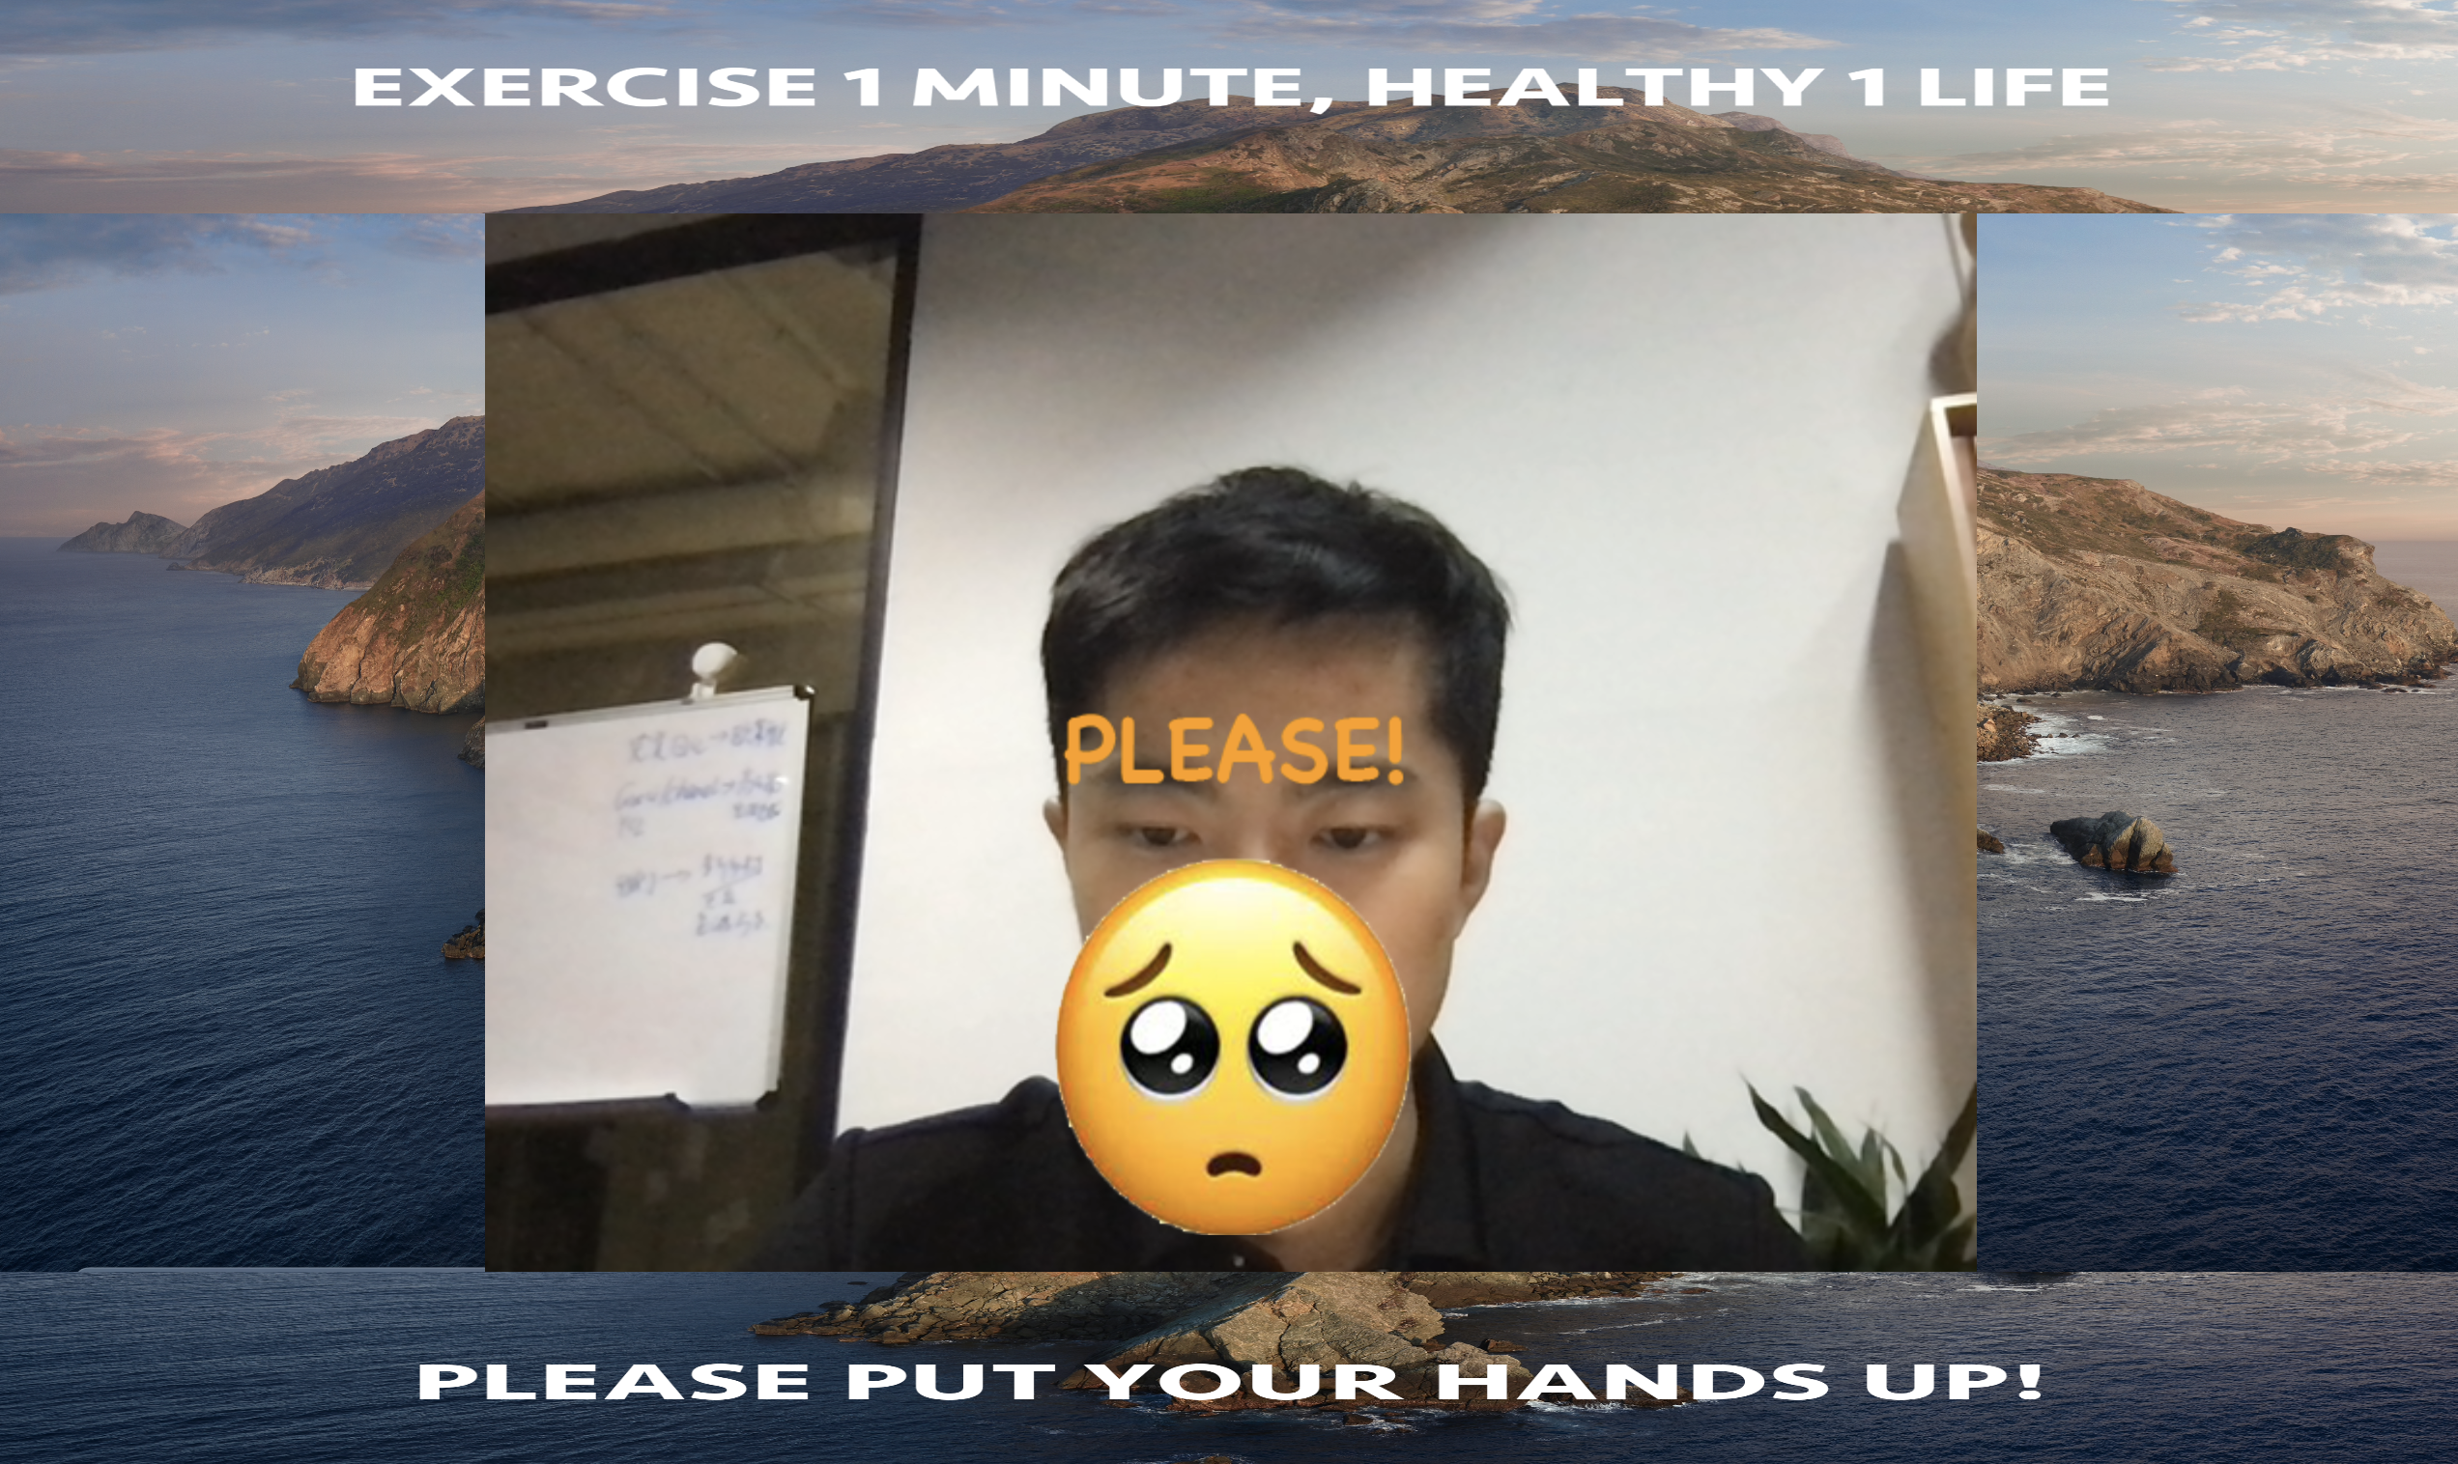
Don’t for get to exercise for 1 minute
For whom?
——— People who need to sit before computer for a long time and forget to exercise
Why I want to do this?
Want to Exercise
Cost me much time
No Exercise( Sometimes, I want to do exercise, however I may think usual exercise may take a lot of time or I need to prepare for it ,and then when I am busy, I may don’t want to exercise and tell ourselves that I can do that when I have time. What a pity!)
busy
Less is more
Only 1 minute many times a day
Foster a good habit!
How?
——— Using pose net to get gestures to make an interesting interactive game for people to make them interested in 1 minute exercise

Slide 2
Original UI
These can be replaced!
Notes:
Do correct exercise and let’s get moving!
Upload
Change
You can upload your avatar and background

Slide 3
Struggles
1. Get familiar with pose net and write short and clear code
At first, I am not familiar with the usage of pose net of P5, I write a lot of code to make it work, however, it didn’t work anymore at first, I was so frustrated. Later, I spend much time on watching some videos on how to use pose net, like videos from the coding train, and gradually I know their structure and change my code to easier way, at that moment, I began to know what was important for us beginners was not great skills but the understanding of different ways to write clean code!
2.Get familiar with the use of p5 in web ( need to finish，I will catch up）
For this part, I need more time to understand the basic concepts of web, because I think the usage of p5 in web is not very difficult ,but how to connect it well with web and let p5 really help me is important, because I may only use Javascript or just put p5 in web structure, this is not the right way.

Slide 4
Next step
1.Adding notice from website and set a rank with friends. Maybe I can make an apple watch edition and let more people join in 1 minute exercise. And this may need the knowledge of server and client and also app development.
2.Achieve the goal of exchange data by uploading pictures from users ( need to finish).
Projetc: https://github.com/0-MarcoHorse-1/exerciseeveryday1.git

